Slide 1
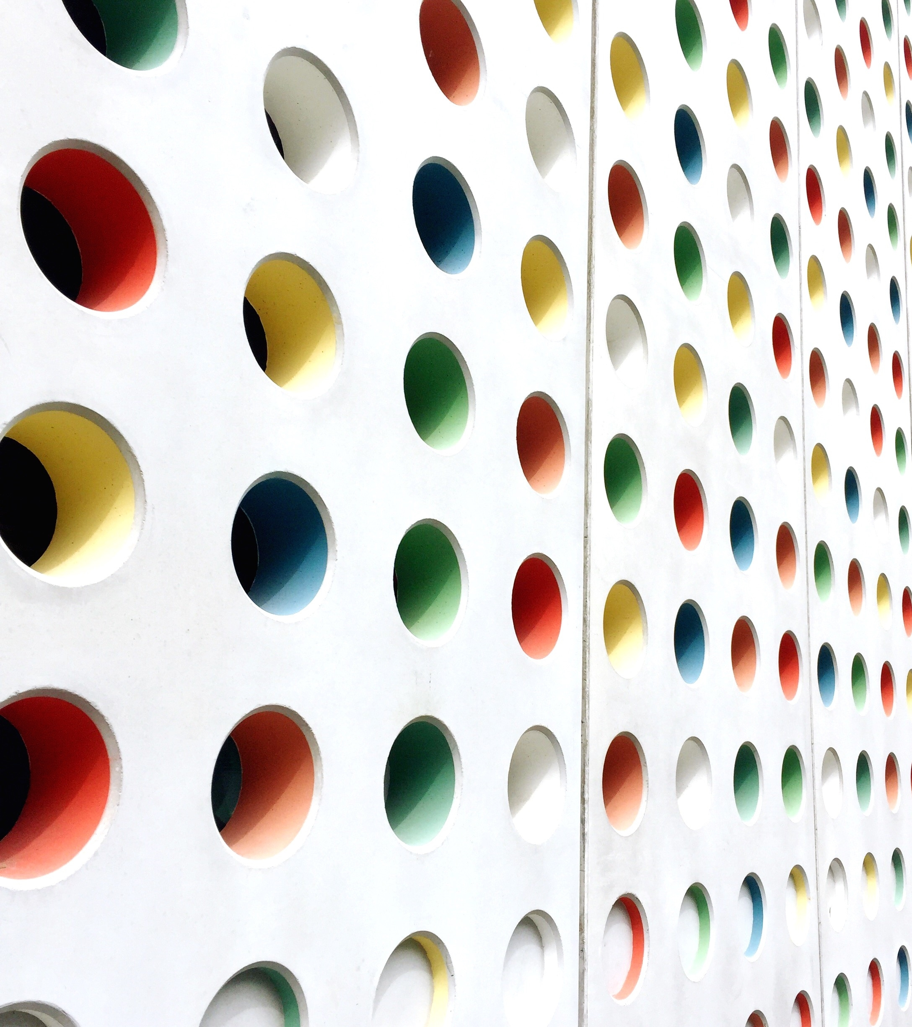
3rd Grade Open House 2020-2021
Mrs. Moreno & Ms. O'Neill

Slide 2
Daily Schedule
Schedule | Chocolate Chips | Oreos
8:35-9:00 | Journal writing | Journal writing
9:00-10:30 am | Math | ELA
10:30-10:45 am | Mask break/Teacher travel | Mask break/Teacher travel
10:45-12:25 | ELA | Math
12:25-1:30 | Lunch | Lunch
1:30-2:15 | Monday Science Tuesday Social Studies Thursday Science Friday Social Studies | Monday Social Studies Tuesday Science Thursday Social Studies Friday Science
2:15-2:45 | Community Meeting | Community Meeting
*Times can vary based on technology and transition times of in person students participating in our in-person instruction.

Slide 3
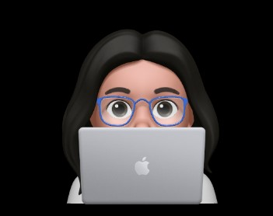
Who is Mrs. Moreno?
I have been teaching for 13 years in the Yonkers Public Schools.
I've taught many different grades and schools from kindergarten through 6th grade.
My favorite grade to teach is 3rd grade because that was my favorite teacher and my favorite school to teach in is School 13 because this is the neighborhood I grew up in.
I have 5 kids from ages 8 to 21. 3 are in the Yonkers Public Schools and 2 are in College.
The best way to reach me is on Class Dojo. However my email address in cmoreno@yonkerspublicschools.org. You can always look at the school's webpage for updates as well.
Remember that you can always come to me or Ms. O'Neill with your questions or concerns first.

Slide 4
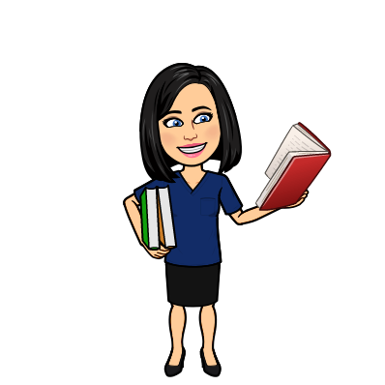
Who is Ms. O'Neill?
I taught at School 13 since 1998.
I have taught many grades including Kindergarten, 2nd, 3rd 4th and 5th grade.
I have two boys ages 15 and 17 and a dog named Bella.
If you need to reach me, the best way is on Class Dojo or teams. However, my email address is joneill@yonkerspublicschools.org. You can always visit the school's homepage for info on the classroom.
Always remember to contact Mrs. Moreno or myself with any questions or concerns and we will always try our best to accommodate you.

Slide 5
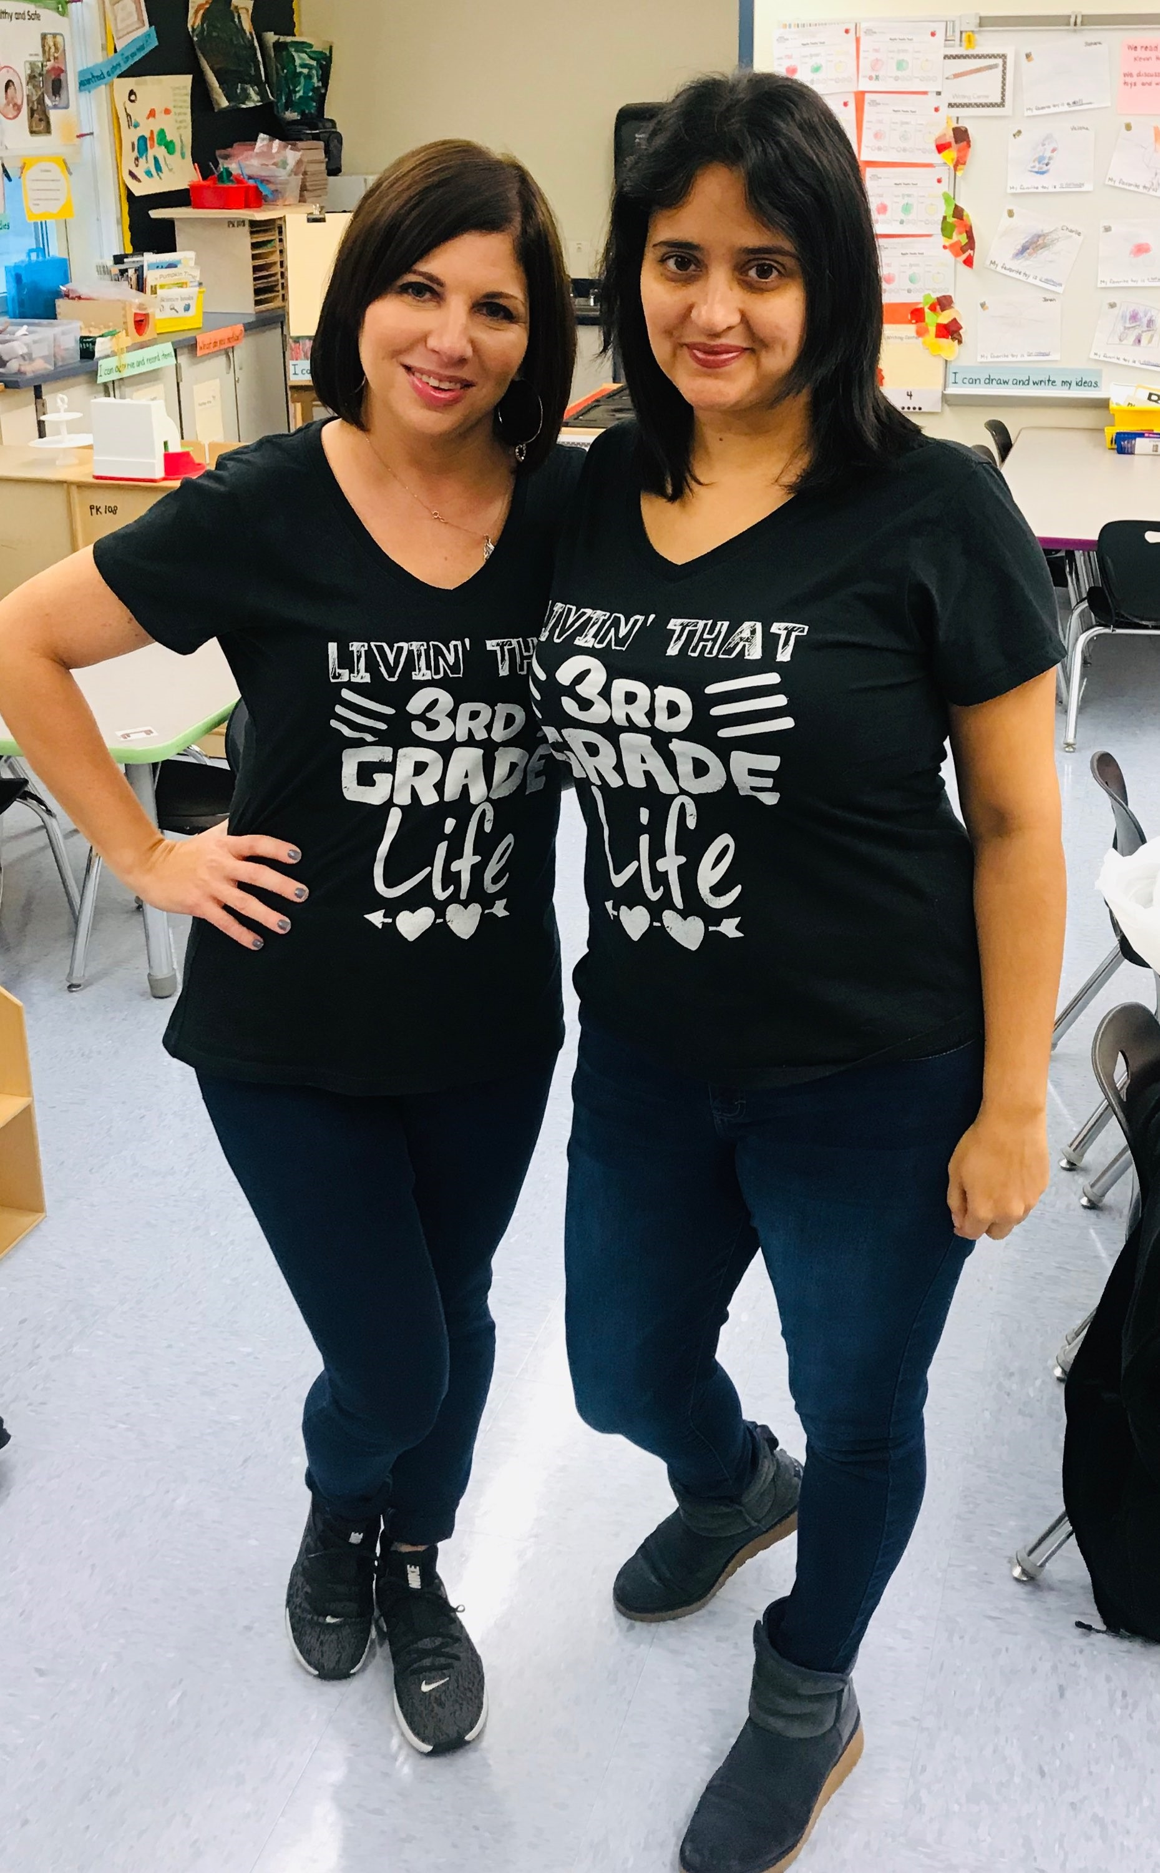
Why do we teach?
It was something special that brought the two of us together 7 years ago. The fact the we both came from this neighborhood makes it even more special. We are vested in making sure "our babies" succeed. South Yonkers is where we grew up. We played in these parks. We shopped in these stores. Mrs. Moreno went to school 13 all of her elementary years. Ms. O'Neill went right up the street to School 21. It is an honor for us to watch your children grow and learn in the same neighborhood we did! Together with your guidance we can empower them to be the best they can be!

Slide 6
Math Curriculums/Instructional Platforms
Eureka Math/EngageNY
Datamate
Clever apps including but not limited to sumdog/brainpop/splashlearn/xtramath

Slide 7
Science Curriculums/Instructional Platforms
Mystery Science
Clever apps like brainpop
STEAM Challenges/projects

Slide 8
ELA/SS Curriculum/Instructional Platforms
Benchmark Advance
BOCES blended SS Curriculum
Clever apps including readworks, common lit, nearpod

Slide 9
Safety Expectations for Hybrid Learners
Lunches from home must be in disposable bag/they can bring small healthy snack as well
Students must wear masks at all times other than during their mask breaks.
Practice the 3Ws (Wear Watch Wash)
Be sure to take your child's temperature each day before school. Temperature must not exceed 100 or higher for child or anyone in the household.
Be sure to fill out the Student Covid questionnaire each day before arrival to school.
Fill out the Digital emergency card that is on our website and on DOJO if you have not already.
Make sure students take all possessions home each day as rooms are thoroughly cleaned each night.

Slide 10
Housekeeping
Attendance-ALL cohorts need to be in attendance whether online or in person 5 days a week for ALL subjects and during the ENTIRE duration of the class. Cameras should remain on and microphones MUTED.
HOMEWORK-Needs to be handed in by the DUE DATE and on TIME!
SUPPLIES-By now supplies need to be in whether you are remote or in class. All students need to have supplies on hand. No one can share.
Meetings-Noone should be starting their own meetings. You can prepare for a scheduled meeting 2-3 minutes ahead of time to ensure your TEAMS is working. However students should not be in lobby without teacher supervision. No chats, or additional meetings should be occurring after instructional meetings.

